Slide 1



BACHELOR OF ENGINEERING
DEPARTMENT OF ELECTRICAL AND ELECTRONICS ENGINEERING
A Technical Seminar
On
BOOST-DERIVED HYBRID CONVERTER WITH SIMULTANEOUS DC
AND AC OUTPUTS
Under the Guidance of
Mrs. Shailaja B M
Asst . Professor, Dept. of EEE
JIT, DVG
NAME | USN No.
Malatesh Kumar K P | 4JD17EE409
Jain Institute of Technology
Davanagere, Karnataka, India
Academic Year 2019-2020

Slide 2
Abstract
A hybrid converter topologies which can supply simultaneously AC as well as DC from a single DC source.
The new Hybrid Converter is derived from the single switch controlled Boost converter by replacing the controlled switch with voltage source inverter (VSI).
This new hybrid converter has the advantages like reduced number of switches as compared with conventional design having separate converter for supplying AC and DC loads, provide DC and AC outputs with an increased reliability and efficiency.

Slide 3
Content
Introduction
Literature Review
Block Diagram
Circuit diagram
Working Principle
Comparison
Applications & Advantages
Conclusion
References

Slide 4
Introduction
In this system there is DC as well as AC loads supplied by different kinds of energy sources using efficient power electronic converters.
Here we considered two types converters that can preforms same operation in this system in which single DC source supplies both AC and DC loads.
Fig. 1(a) shows the conventional architecture in which DC and AC load supplied by separate DC-DC converter and DC-AC converter from a single DC source respectively.
Whereas in Fig. 1(b) referred as hybrid converter in which a single converter stage perform both operations.

Slide 5
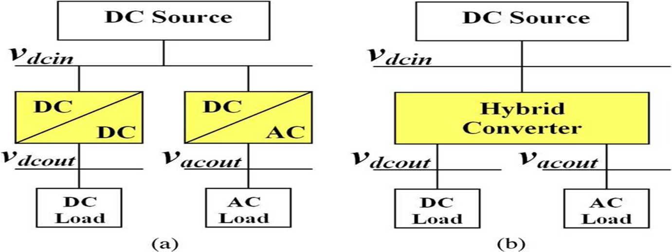
BLOCK DIAGRAM

Slide 6
LITERATURE REVIEW
1. “Study and Implementation of Boost-Derived Hybrid Converter With Simultaneous DC and AC Outputs”-Prabal.singh
In this paper a work is done on the new topology of converter that can convert DC and AC outputs from a solitary dc input in a single stage. This topology can be achieved by using VSI bridge network in place of controlled single switch if step-up stage architecture to supply hybrid loads.
2. “ A Survey On Boost Derived Hybrid Converter For Simultaneous DC And AC Applications”- R. Kalai Selvi
This Paper introduces new hybrid converter topologies which can supply simultaneously AC as well as DC from a single DC source. This new hybrid converter has the advantages like reduced number of switches.
3.“Boost Derived Hybrid Converter For Simultaneous DC And AC Applications”- P.Gowtham
The report of the project is based on the performance of MOSFET based model for boost derived hybrid converter with Sine-PWM technique. Unipolar Sine -PWM technique is apply for boost derived hybrid converter.

Slide 7
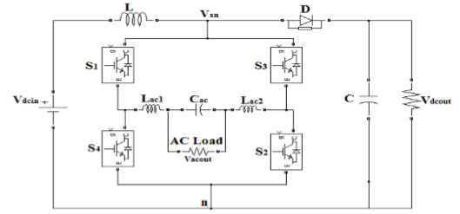
CIRCUIT DAIGRAM
Fig. : Hybrid converter-based architecture

Slide 8
WORKING PRINICIPLE
In the operation of hybrid converter is concerned this is equivalent to switching on controllable switch of the conventional boost converter.
The BDHC has three distinct switching states as described below:
INTERVAL 1: Shoot-Through Interval
INTERVAL 2: Power interval
INTERVAL 3: Zero interval

Slide 9
COMPARISITION B/W
a) Conventional converter | b) Hybrid converter-based architecture
Larger in size. | Smaller in size.
Cost is more. | Less cost.
Less efficiency. | High efficiency.
Non-Reliable in nature. | Reliability in nature.
More Switching loss | Switching losses is less

Slide 10
ADVANTAGES AND APPLICATIONS
Advantages
Smaller in size
Less cost
At simultaneous period both ac and dc can be get
High efficiency
Reliability in nature
Switching loss is less
Application
Military
Aerospace
Nanogrid

Slide 11
CONCLISION
This method proposes new Hybrid converter topologies which can supply simultaneously both DC and AC loads from a single DC supply.
The proposed hybrid converter has the following advantages, shoot-through condition does not cause any problem on working of the circuit hence improves the reliability of the system, & Limitations on voltage gain can be achieved by BDHC topology.

Slide 12
REFERENCES
Prabal.singh_mtee15@gla.ac.in” Study and Implementation of Boost-Derived HybridConverter With Simultaneous DC and AC Outputs”.[1]
2. R. Kalai Selvi Associate Professor, Dept. of EEE, PET Engineering College,Tirunelveli, Tamil Nadu, India” A Survey On Boost Derived Hybrid Converter For Simultaneous DC And AC Applications”[2]
3. P.Gowtham Assistant Professor Karpaga Vinayaga College of Engineering and Technology, pgowtham185@gmai l“Boost-Derived Hybrid Converter With Simultaneous DC and AC outputs”[3]

Slide 13


